Slide 1


Slide 2


Report Title: An Overview About Amrita Consumer Food Products Ltd.
Name: Hamidul Munsi
ID: 01-020-07
Batch No: 20
Department of Political Science
Date: 05-10-2024

Slide 3

Introdution to the Company:
Established in 1998
2006 – Amrita Food Product & Amrita Consumer were merged as Amrita Consumer Food Products Ltd.
2009- The Company got ISO certificate
2001- The company got GMP certificate
2012- Company got Health HACCP certificate

Slide 4
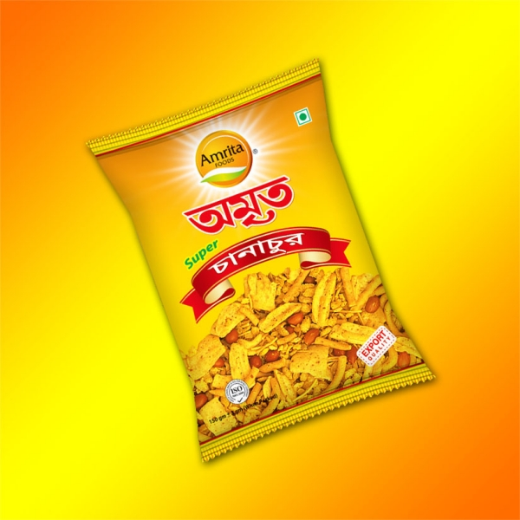

Key Product & Services
Spices
Snaks
Semai
Chatny
Oil
Noodls
Rice
Flour
Fruit Jell
Candy

Slide 5
Product Cost & Sales
Product name | Cost | Sales
Turmeric | $150,000 | $170,000
Chili Power | $120,000 | $140,000
Pachforan | $50,000 | $80,000
Chanachur | $180,000 | $230,000
Dal Bhaja | $80,000 | $100,000
Mango Juice | $110,000 | $150,000

Slide 6
Final Thought & Concluding Remark
Amrita Consumer Food and Products Ltd. is a fast-growing FMCG company focused on quality, affordability, and sustainability. With a strong market presence and plans for expansion, it is well-positioned for future growth.
Address
Head Office: 9/1, A.C Roy Road, Armanitola, Dhaka-1100, Bangladesh.
Corporate Office: 119, Amrita Lal Dey Road, Barishal-8200, Bangladesh.
Factory: Amrita Nagor, Pangsha, P.S: Biman Bondor, Upazila: Babugonj, Barishal, Bangladesh.
Contacts
+88 01709 392 896 +88 01709 392 855
Email
info@amritaconsumer.com

Slide 7

Advertisement

Slide 8

Thank You Everyone

